Slide 1



Chowgacha - Jhenaidah Model: A New Dimention of Health Service Development.
Dr. Md.Emdadul Haque
Senior National Consultant C -J model replication committee

Slide 2
Background History of C-J Model
The program starts in Chowgacha UHC in 1986.
Social mobilization program starts in Lohagara UHC , Narail from 1989 - 1995
In 1995-97 open 4 section a) ANC corner,b) Under-5 corner c)birth&death record ing unit.d) Health education corner
In june 2008 ,MOH&FW decleared the Chowgacha UHC as Model UHC of Bangladesh.
In 2010 D G of WHO recommended to replicate it.
Jhenaidah Sadar Hospital Model starts in 2012
C-J Model replicate in 2015 by MOHFW in 11 district hospital& 5 Upazilla UHC.Now replicating by the order of PM office,ADG(Admin)is ChairPerson.

Slide 3




Community Mobilization Meeting at Lohagara in 1995

Slide 4



CHOWGACHA UPAZILA HEALTH COMPLEX
Chowgacha, Jessore.
Previous UHC
Present UHC

Slide 5
A Sub-district level Hospital with a Vision …
Maximum utilization of Govt.
resources with
honesty and sincerity.
Integrated approach of
Administration, Community
Leaders .
Providing Effective services
through improved
management system.

Slide 6


Blood donation program stared in 16 December, 1996 in Chowgacha UHC
A seminar held on basic information system at Chowgacha Degree College in June, 1997. DC Jessore was the chief guest .

Slide 7


Community supported volunteer working in ANC corner
Community Supported Volunteer Working as receptionist.

Slide 8
Achievement of Chowgacha Health Complex
In 2008, Chowgacha Health Complex declared as the model upazilla health complex.
  All the components of primary health care implemented in Chowgacha in 2000.
  Chowgacha UHC became the best EOC center with 98.4% (4413)delivery rate
  Chowgacha UHC achieved MDG target in 2009
  .
  Chowgacha Health complex is awarded for best performance in EOC form 2004 to 2014& 2017.

Slide 9
Upazilla Health Complex
CHOWGACHA , JESSORE.
COMMUNITY SUPPORTED MANPOWER
TOTAL :46
  Volunteers :26
  Cleaners & guards :16
  Others :04
  The remunerations come from
  Outsourcing :25
  Service provider :21
  The amount of remuneration ranging from 200/= To 8000/=tk. Per month depending upon the style of work, which costs a total of nearly 90,ooo/=Tk per month.

Slide 10
Chowgacha Health Complex – improvement evaluation (1995-2017)
Subject | 1995 | 1996 | 2000 | 2007 | 2011 | 2017
Bed Occupancy Rate % | - | - | 93.5 | 201 | 208 | 171
ANC (First Visit) | - | 16.3 (817) | 59 (2861) | 132 (7292) | 170 (8935) | 130 (6632)
Hospital Delivery Rate % | - | 2.1 (99) | 6.4 (422) | 38.1 (1899) | 98.4 (4413) | 66 (2932)
C-Section rate % | - | .02 (1) | 0.07 (3) | 9.6 (473) | 22.5 (1107) | 17
MMR/100,000 live birth | 599 | 300 | 168 | 160 | 68 | 91
NMR/ 1000 live birth | 42 | 47 | 23 | 21.5 | 18.2 | 16.6
IMR/ 1000 live birth | 65 | 58 | 36 | 29.2 | 23.6 | 18.6
U5MR/ 1000 live birth | 78 | 67 | 44 | 33.3 | 25.7 | 21.1

Slide 11

100 kh¨v wewkó m`i nvmcvZvj, wSbvB`n

Slide 12
Challenges of the hospital in 2012
In secured hospital environment.
Performance of all activities was very low.
Very limited support staff.
Receiving money from the patients by non-govt. staff.
Waste management system was poor.
Monitoring meeting was not performed regularly

Slide 13
Comparative data of health facilities of different country of the world
SL NO | Country | Per capita health Expenditure per year by Govt. ($) | Doctors per 10000 Population | Nurse per 10000 Population | Beds per 10000 population | Out of pocket expenditure %
01 | USA | 9536 | 25.5 | 99 | 37 | 11.08
02 | UK | 4356 | 28.0 | 84 | 30 | 14.79
03 | Malaysia | 386 | 12.8 | 34 | 18 | 36.67
04 | Sri Lanka | 118 | 7.3 | 17.5 | 31 | 38.43
05 | India | 63 | 7.3 | 20.4 | 09 | 65.06
06 | Nepal | 44 | 08 | 4.7 | - | 60.41
07 | Pakistan | 38 | 08 | 06 | 06 | 66.40
08 | Bangladesh | 37 | *05 | *03 | *05 | 67.00
From internet 2018

Slide 14

Sadar Hospital, Jhenaidah
Bed Occupancy Rate from 1998 to 2018

Slide 15
Emergency & Out Door, Indoor Service 1998 to 2018
Sadar Hospital, Jhenaidah

Slide 16
3 best performing EmOC Hospital in Khulna division - 2018
Sadar Hospital, Jhenaidah

Slide 17
Comparative data of revenue income (in Taka) from 2015 to 2018
Sadar Hospital, Jhenaidah

Slide 18
Community Support System in Sadar Hospital
56 manpower (Cleaner 21, Ayah & ward boy 22, Guard 7, Volunteer 3, Trolley man 3 ) is supported by the community.
MP of Jhenaidah-2 supports 14, Zahedee foundation 12 , Mayor of Jhenaidah Paurasava 5, doctors of Jhenaidah support 17 manpower.
Mayor of Jhenaidah Paurasava plays an important role in security , cleanliness, renovation of pediatric word and arrange a mayoral conference.
Retired secretary donated a generator, Zahedee foundation donated an inter-com, mayor donated a biochemistry analyzer.

Slide 19
Community Support System in Other Hospitals
District Hospitals:Chuadanga, Jessore, Magura, Kox-bazar, Joypurhat-District, Bogura-District,Thakurgoan (20 District Hospital)
Upazilla Health Complex: Koatchandpur, Horinakundu, Monpura, Malendah, Birgonj ,Jekhorgacha, Monirampur,Meherpur(40-Upazilla Health Complex)
Community Support Commette headed by Mayor of Powrosova in 2015.
C-J Community Engazed Health Management Model headed by ADG(Admin) DGHS-Stratigic Plan Devlopment

Slide 20



KAIZEN(CQI)
A frontline-based problem solving approach
Incremental but continuous progress

Slide 21


INNOVATION
Dramatic but intermittent progress
THE IDEAL
ACTUALITY
Higher standard achieved through innovation is subject to deterioration unless continuing efforts are made first to maintain it and then to improve it

Slide 22
KAIZEN PLUS INNOVATION
Desirable progress by combination of two opposing approaches
MAINTENANCE
INNOVATION
NEW STANDARD
KAIZEN
MAINTENANCE
INNOVATION

Slide 23







KAIZEN in Jhenaidah Sadar Hospital
Before
After

Slide 24


Local Govt. (Paurashava) Participation
Before
After
Before
After

Slide 25




KAIZEN in Jhenaidah Sadar Hospital
Color code
Color code
Use of direction sign
waist segregation

Slide 26


KAIZEN in Jhenaidah Sadar Hospital
m
Health education session
Community engagement

Slide 27


KAIZEN in Jhenaidah Sadar Hospital
Recovered Valuable land after sixty years.
Arranged get man to control crowed in ward by Community support

Slide 28
Achievements of Jhenaidah Sadar
Hospital
1. Active Community Participation is an example in Bangladesh.
2. Improved performance of all services.
3. Improved Cleanliness and Beautification of Campus.
4. Functioning of X-Ray service and Biochemistry investigation
5. Improved Security
6. Improved Financial Management
7. “Model ” is replicating in 11 district and 5 upazilla hospital
8. The hospital is awarded 7 times from 2013 to 2018.

Slide 29
Need to implement health related SDG
by 2030
01 M.A in every community clinic
10 bedded hospital with 2 doctors, 6 nurses and paramedics in every union.
100 bedded hospital In every upazilla
500 bedded hospital in every district.

Slide 30


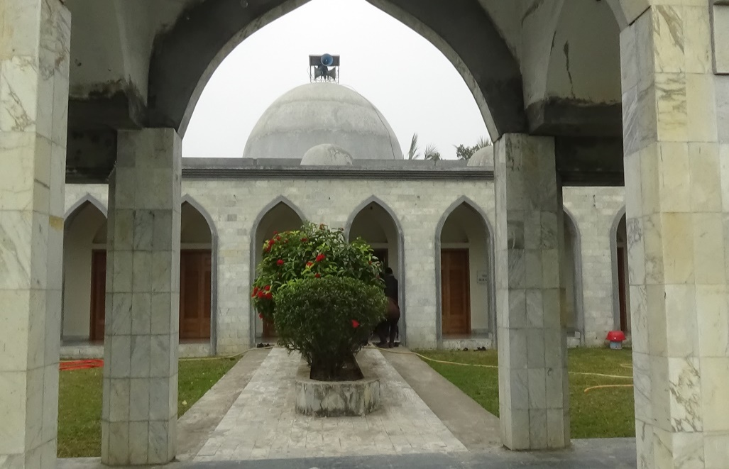
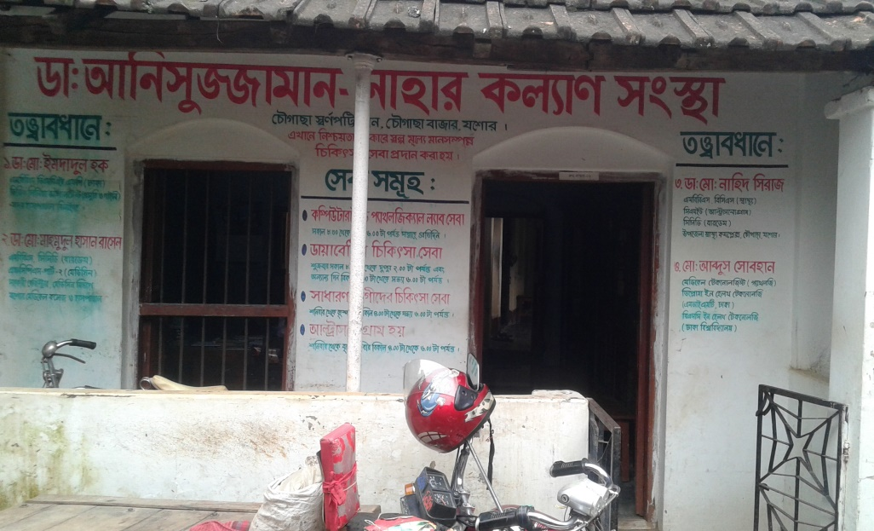
Development of Chowgacha Upazilla by Divine Group

Slide 31

Thank You
Notes:
31

